Slide 1

Social network and peace in society
BY:
Ayesha Mushtaq
Raheel shehzad Robson
Fahad Mahmood
David okafor

Slide 2

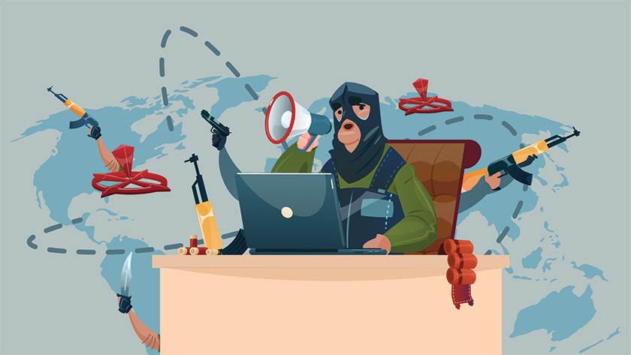
Problem statement
The increasing frustration, intolerance and mass killing has been reached to alarming level.
the economy and environment has suffered because of social unrest
social networks have been handy tool for such extreme elements, and they are using this technology for spreading hate and terrorism

Slide 3

Related work
Social media a digital tool of mass communication
Social media and peace building
Social media and conflicts
Social network & their policy on account suspension

Slide 4
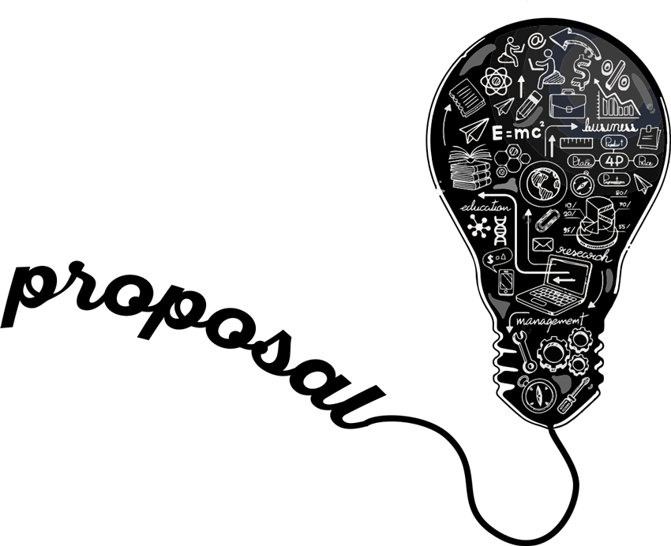
Proposed solution
We have created an API which can be integrated with social networks to verify if the post content is from authentic source.
It is using Kaggle dataset.
We are proposing this api to be integrated with social networks sites to verify content.

Slide 5
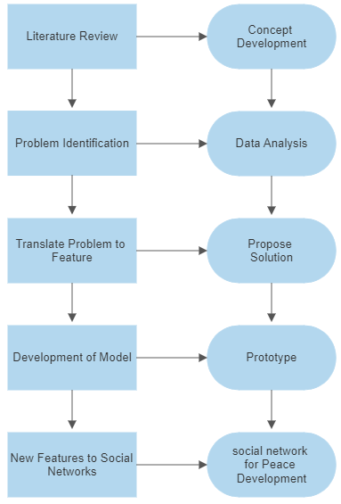
Design methodology

Slide 6

implementation
The implementation of this tool is done in python
It is loading the data from dataset and training the model on the basis of that data.

Slide 7
Evaluation
Evaluation though NLP model.
The content is being evaluated through Kaggle dataset.

Slide 8
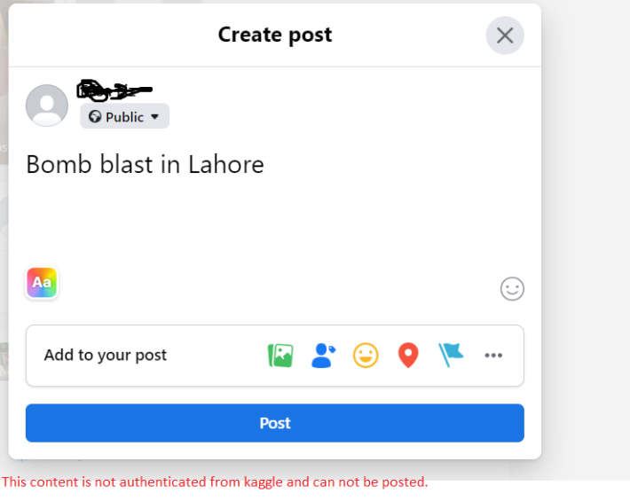
Expected outcomes

Slide 9
Conclusion & Future work
Peaceful society formation is possible in result of correct and meaningful usage of social network sites
Respect of political and other views can be established through interactive approach with different mi
In the future we can expand datasets and add newapi as the news source. We can also create a visualization of this tool in future
The suggestion on groups promoting the peace and implementation of ranks to the groups that achieve goals defined by UN can also be done in future studies.

Slide 10

Any question??

